Slide 1
Managerial Accounting and Cost Concepts
Chapter 1
Notes:
Chapter 2: Managerial Accounting and Cost Concepts. In this chapter we explain how managers need to rely on different cost classifications for different purposes. The four main purposes emphasized in this chapter include preparing external financial reports, predicting cost behavior, assigning costs to cost objects, and decision making.

Slide 2
Learning Objective 1
Understand cost classifications used for assigning costs to cost objects: direct costs and indirect costs.
Notes:
Learning objective number 1 is to identify and give examples of each of the three basic manufacturing cost categories.

Slide 3
Direct and indirect costs
Cost object is anything for which cost data are desired (e.g., products, customers, production lines) / Any item that a company wishes to measure separately.
Cost object is anything for which we want to calculate a cost
Cost classifications
Direct costs
Indirect costs
Cost that can be easily traced to a specified cost object. e.g., tyres used to manufacture a car.
Cost that cannot be easily traced to a specified cost object. Also called common cost. e.g., managers’ salary.

Slide 4
Learning Objective 2
Identify and give examples of each of the three basic manufacturing cost categories.
Notes:
Learning objective number 1 is to identify and give examples of each of the three basic manufacturing cost categories.

Slide 5
Classifications of Manufacturing Costs
Direct Materials
Direct Labor
Manufacturing Overhead
The Product
(also, the cost object)
Notes:
Manufacturing costs are usually grouped into three main categories: direct materials, direct labor, and manufacturing overhead. These costs are incurred to make a product.

Slide 6
Direct Materials
Raw materials that become an integral part of the product and that can be conveniently traced directly to it. It becomes an integral part of the finished product.
Example: A radio installed in an automobile, car seats, wheels, engine.
Notes:
Direct materials are raw materials that become an integral part of the finished product and whose costs can be conveniently traced to it. Examples include the aircraft engines on a Boeing 777, the Intel processing chip in a personal computer, the blank video cassette in a pre-recorded video, and a radio in an automobile.

Slide 7
Direct Labor – sometimes touch labor
Those labor costs that can be easily traced to individual units of product.
Example: Wages paid to automobile assembly workers
Notes:
Direct labor consists of that portion of labor cost that can be easily traced to a product. Direct labor is sometimes referred to as “touch labor,” since it consists of the costs of workers who “touch” the product as it is being made.

Slide 8
Manufacturing Overhead
Manufacturing costs that cannot be easily traced directly to specific units produced but essential in operating the factory.
Examples: Indirect materials and indirect labor
Materials used to support the production process. Examples: lubricants and cleaning supplies used in the automobile assembly plant.
Wages paid to employees who are not directly involved in production work. Examples: maintenance workers, janitors, and security guards.
Manufacturing overhead = indirect materials + direct labor
Notes:
Manufacturing overhead includes all manufacturing costs except direct materials and direct labor. These costs cannot be easily traced to specific units produced (also called indirect manufacturing cost, factory overhead, and factory burden).
Manufacturing overhead includes indirect materials that are part of the finished product, but that cannot be easily traced to it. It includes indirect labor costs that cannot be conveniently traced to the creation of products.
Other examples of manufacturing overhead include: maintenance and repairs on production equipment, heat and light, property taxes, depreciation and insurance on manufacturing facilities, etc.

Slide 9
Making sense of manufacturing costs
-Manufacturing costs are helpful to understand product and production costs.
Total product cost (or per 1 cost object/unit) =
Direct material + Direct labor + Manufacturing overhead.
Prime cost
Conversion cost
Note that when calculating product cost per unit, we need to divide total costs per total units.
Direct materials per unit + Direct labor per unit + Mfg O.H per unit

Slide 10
Example
ABC company produced 10,000 units with the following information:
Calculate product cost per unit.
Calculate total product cost.
Calculate conversion cost per unit.
Calculate total conversion cost.
Calculate prime cost per unit.
Calculate total prime cost.
 | Cost per unit
Direct materials | $10
Direct labor | $5
Indirect materials | $2
Indirect labor | $3

Slide 11
Solution
Output = 10,000 units | Cost per unit
Direct materials | $10
Direct labor | $5
Indirect materials | $2
Indirect labor | $3
Product cost per unit = D.M + D.L + Mfg O.H (Indirect M + indirect L)
= $10 + $5 + $5
= $20
Total product cost = $100,000 + $50,000 + $50,000 (or $20*10,000)
= $200,000
Conversion cost per unit = D.L + Mfg O.H
= $5 + $5
= $10
Total conversion cost = $50,000 + $50,000 (or $10*10,000)
= $100,000

Slide 12
Solution (Cont’d)
Output = 10,000 units | Cost per unit
Direct materials | $10
Direct labor | $5
Indirect materials | $2
Indirect labor | $3
Prime cost per unit = D.M + D.L
= $10 + $5
= $15
Total prime cost = $100,000 + $50,000 (or $15*10,000)
= $150,000

Slide 13
Nonmanufacturing Costs
Selling Costs
Administrative Costs
can be direct and indirect
Costs necessary to secure the order and deliver the product. e.g., advertising, shipping, sales travel
All executive, organizational, and clerical costs. e.g., executive salary, public relations, secretarial
Notes:
A manufacturing company incurs many other costs in addition to manufacturing costs. For financial reporting purposes, most of these other costs are typically classified as selling costs and administrative costs. These costs are also called selling, general and administrative costs, or SG&A. Selling and administrative costs are incurred in both manufacturing and merchandising firms.
Selling costs include all costs necessary to secure customer orders and get the finished product into the hands of the customer. These costs are also referred to as order-getting and order-filling costs. Examples of selling costs include advertising, shipping, sales travel, sales commissions, sales salaries, and costs of finished goods warehouses.
Administrative costs include all executive, organizational, and clerical costs associated with the general management of an organization. Examples of administrative costs include executive compensation, general accounting, secretarial, public relations, and similar costs involved in the overall general administration of the organization as a whole.

Slide 14
Learning Objective 3
Understand cost classifications used to prepare financial statements: product and period costs
Notes:
Learning objective number 2 is to distinguish between product costs and period costs and give examples of each.

Slide 15
Product Costs Versus Period Costs
Product costs (inventoriable costs) = direct materials + direct labor + manufacturing overhead.
When we sell a product, it is released from inventory (inventoriable).
3 inventory accounts on B.S:
Raw materials: go in the final product.
Work in process: partially completed.
Finished goods: completed product.
Period costs = selling exp. + administrative exp.
Expense
Income Statement
Note: revisit matching principle
Notes:
Costs can also be classified as product or period costs.
Product costs include all the costs that are involved in acquiring or making a product. More specifically, it includes direct materials, direct labor, and manufacturing overhead. Consistent with the matching principle, product costs are recognized as expenses when the products are sold. This can result in a delay of one or more periods between the time in which the cost is incurred and when it appears as an expense on the income statement. Product costs are also known as inventoriable costs. The discussion in the chapter follows the usual interpretation of GAAP in which all manufacturing costs are treated as product costs.
Period costs include all selling costs and administrative costs. These costs are expensed on the income statement in the period incurred. All selling and administrative costs are typically considered to be period costs. The usual rules of accrual accounting apply to period costs. For example, administrative salary costs are “incurred” when they are earned by the employees and not necessarily when they are paid to employees.

Slide 16
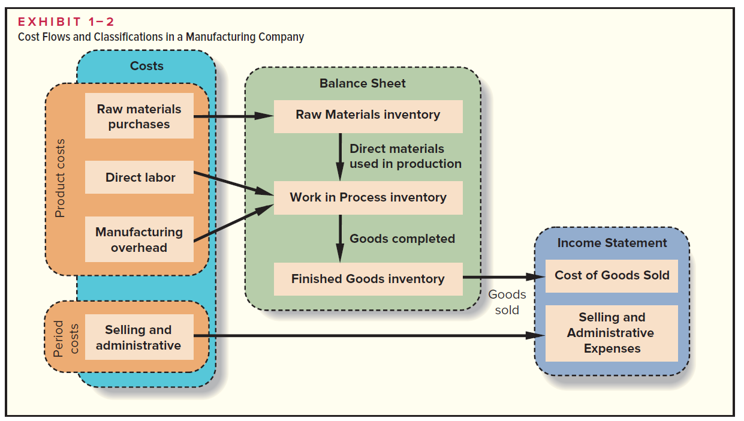

Slide 17
Quick Check ✓
Which of the following costs would be considered a period rather than a product cost in a manufacturing company?
A. Manufacturing equipment depreciation.
B. Property taxes on corporate headquarters.
C. Direct materials costs.
D. Electrical costs to light the production
facility.
E. Sales commissions.
Notes:
Which of the following costs would be considered a period rather than a product cost in a manufacturing company?

Slide 18
Quick Check ✓
Which of the following costs would be considered a period rather than a product cost in a manufacturing company?
A. Manufacturing equipment depreciation.
B. Property taxes on corporate headquarters.
C. Direct materials costs.
D. Electrical costs to light the production
facility.
E. Sales commissions.
Notes:
Property taxes on corporate headquarters and sales commissions are period costs. All of the other costs listed are product costs.

Slide 19
Learning Objective 4
Understand cost classifications used to predict cost behavior: variable costs, fixed costs, and mixed costs.
Notes:
Learning objective number 3 is to understand cost behavior patterns including variable costs, fixed costs, and mixed costs.

Slide 20
Cost Classifications for Predicting Cost Behavior
Cost behavior refers to how a cost will react to changes in the level of activity. The most common classifications are:
Variable costs.
Fixed costs
Mixed costs.
Cost structure: the relative proportion of each type of cost in an organization.
e.g., 70% variable + 30% fixed (or) 60% fixed + 40% variable.
Notes:
Quite frequently, it is necessary to predict how a certain cost will behave in response to a change in activity. For example, a manager may want to estimate the impact that a 5% increase in sales would have on the company’s total electric bill. Cost behavior refers to how a cost will react to changes in the level of activity within the relevant range. The most commonly used classifications of cost behavior are variable and fixed costs.

Slide 21

Variable Cost: for a cost to be variable, it must be variable with respect to something
Refueling your car is based on how many liters you pump.
Total refueling bill
Number of litres
Notes:
A variable cost varies, in total, in direct proportion to changes in the level of activity. For example, if you don’t have a texting plan on your cell phone, text messaging costs 5 cents per text. Your total texting bill increases with the number of texts you send.

Slide 22
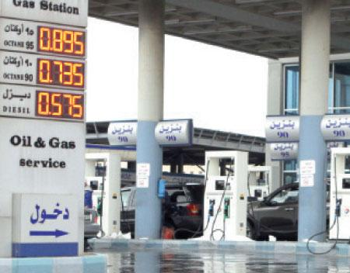
Variable Cost Per Unit
The cost per liter is constant at
0.735 cents per octane 90 liter.
Cost Per liter
Number of liters
*Important: while variable cost change as the activity level changes, variable cost is constant if expressed on a per unit basis.
Notes:
Although variable costs change in total as the activity level rises and falls, variable cost per unit is constant. For example, the cost per text message sent is constant at 5 cents per text.

Slide 23
The Activity Base (Cost Driver): measure of whatever causes the incurrence of a variable cost.
Units produced
Machine hours
A measure of what causes the incurrence of a variable cost
Miles driven
Labor hours
Notes:
An activity base (also called a cost driver) is a measure of what causes the incurrence of variable costs. As the level of the activity base increases, the total variable cost increases proportionally.
Units produced (or sold) is not the only activity base within companies. A cost can be considered variable if it varies with activity bases such as miles driven, machine hours, or labor hours.

Slide 24
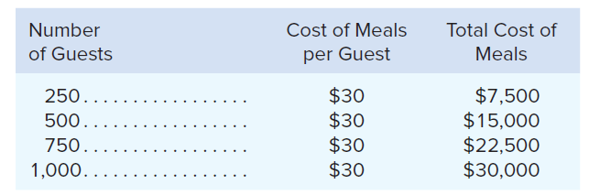
Example of variable cost behavior
Nooksack Expeditions, a small company that provides daylong whitewater rafting excursions on rivers in the North Cascade Mountains. The company provides all of the necessary equipment and experienced guides, and it serves meals to its guests. The meals are purchased from a caterer for $30 a person for a daylong excursion. The behavior of this variable cost, on both a per unit and a total basis, is shown below:

Slide 25
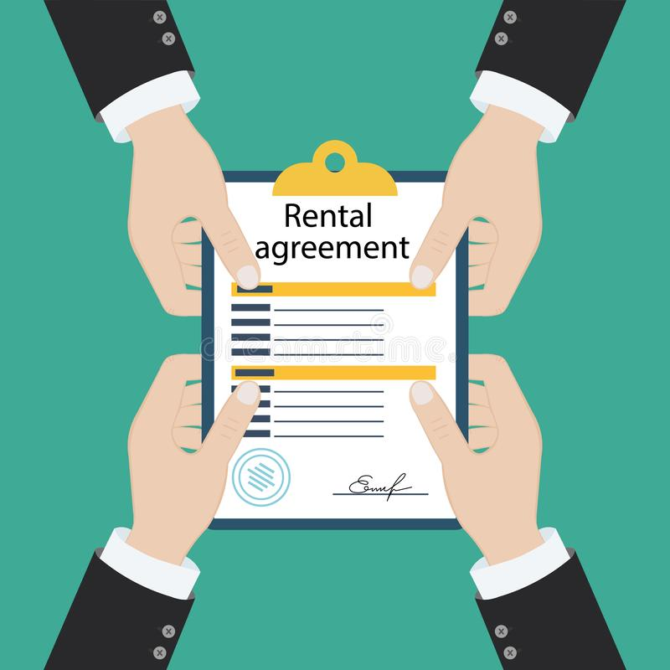
Fixed Cost
Remains constant, in total, regardless of changes in the level of activity. e.g., insurance, rent, supervisory salaries
Monthly factory rent
Monthly production
Notes:
A fixed cost is constant within the relevant range. In other words, fixed costs do not change for changes in activity that fall within the “relevant range.” For example, your monthly contract fee for your cell phone is a fixed amount for a certain number of minutes. The monthly contract fee does not change based on the number of calls you make.
Of course, if you go over your monthly minutes allotment, you have exceed the relevant range for your monthly contract and will be charged above and beyond your monthly contract fee.

Slide 26
Fixed Cost Per Unit
Within the monthly contract allotment, the average fixed cost per cell phone call made decreases as more calls are made.
Monthly Cell Phone Contract Fee
Number of Minutes Used Within Monthly Plan
Notes:
However, when expressed on a per unit basis, a fixed cost is inversely related to activity—the per unit cost decreases when activity rises and increases when activity falls. For example, the average fixed cost per cell phone call made decreases as more calls are made in the month.

Slide 27
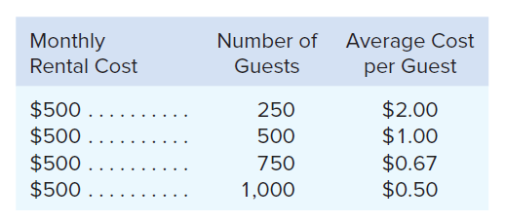
Example of fixed cost behavior
If Nooksack Expeditions has only 250 guests in a month, the $500 fixed rental
cost would amount to an average of $2 per guest.
As a general rule, the book authors caution against expressing fixed costs on an average per unit basis because it creates the false impression that fixed costs are like variable costs, i.e., they change based on the level of activity. This is just for understanding purposes.

Slide 28

Types of Fixed Costs
Committed
Long-term, cannot be significantly reduced in the short term.
Discretionary
May be altered in the short-term by current managerial decisions
Examples
Depreciation on Buildings and Equipment and Real Estate Taxes
Examples
Advertising and Research and Development
Notes:
One type of fixed cost is known as committed fixed costs. These are long-term fixed costs that cannot be significantly reduced in the short term. Some examples include depreciation on buildings and equipment and real estate taxes on factory property.
Another type of fixed cost is known as discretionary fixed costs. These fixed costs may be altered in the short-term by current management decisions. Some examples of discretionary fixed costs include advertising and research and development costs.
A cost may be discretionary or committed depending upon management’s strategy. For example, some construction companies may layoff workers during months with minimal customer demand. However, other construction companies may opt to retain their workers all year.

Slide 29
Fixed costs: the linearity assumption and the relevant range
The relevant range: range of activity within which the assumption that cost behavior is strictly linear is reasonably valid.
Example: suppose a hospital rents a machine for $20,000 per month that tests blood samples. Furthermore, suppose that the capacity of the machine is 3,000 tests per month. The assumption that the rent for the diagnostic machine is $20,000 per month is only valid within the relevant range of 0 to 3,000 tests per month. (fixed cost per unit = $6.6)
What happens if the hospital decided to test 5,000 blood samples or 9,000 blood samples?

Slide 30
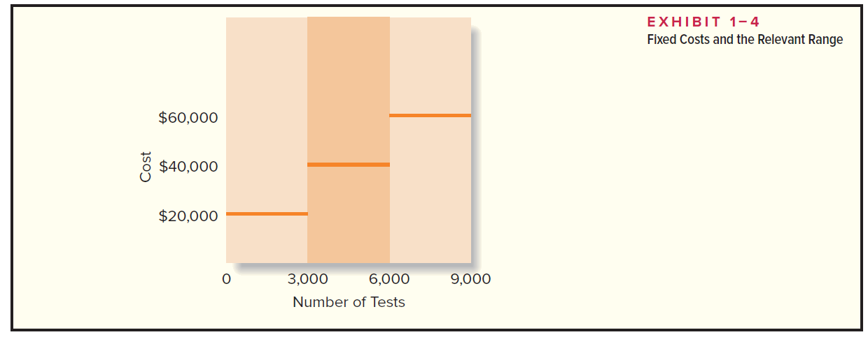
Machine cost = $20,000
Fixed cost when tests are 5,000 = $40,000 (fixed cost per unit = $8)
Fixed costs when tests are 9,000 = $60,000 (fixed cost per unit = $6.6)
Therefore, the rental cost increases in discrete steps or increments of 3,000 tests, rather than increasing in a linear fashion per test.

Slide 31
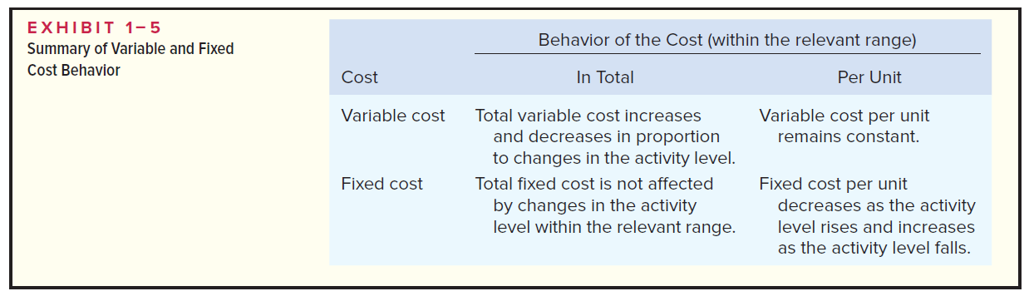
Cost Classifications for Predicting Cost Behavior
Notes:
It is helpful to think about variable and fixed cost behavior in a 2 by 2 matrix, as illustrated here. Take a few minutes and review this summary of cost behavior for variable and fixed costs.

Slide 32
Quick Check ✓
Which of the following costs would be variable with respect to the number of cones sold at a Baskins & Robbins shop? (There may be more than one correct answer.)
A. The cost of lighting the store.
B. The wages of the store manager.
C. The cost of ice cream.
D. The cost of napkins for customers.
Notes:
Which of the following costs would be variable with respect to the number of cones sold at a Baskins and Robbins shop? (There may be more than one correct answer.)

Slide 33
Quick Check ✓
Which of the following costs would be variable with respect to the number of cones sold at a Baskins & Robbins shop? (There may be more than one correct answer.)
A. The cost of lighting the store.
B. The wages of the store manager.
C. The cost of ice cream.
D. The cost of napkins for customers.
Notes:
Right. The cost of ice cream and the cost of napkins for customers would be variable costs. As Baskins and Robbins sells more ice cream cones, we would expect the total cost of ice cream and napkins to increase.

Slide 34
Mixed Costs (also called semivariable costs)
A mixed cost contains both variable and fixed elements. Consider the example of utility cost.
Y
Total mixed cost
Total Utility Cost
Variable Cost per KW
X
Fixed Monthly Utility Charge
Activity (Kilowatt Hours)
Notes:
Mixed costs (also called semivariable costs) contain both variable and fixed cost elements.
The graph depicts the mixed costs of a normal utility bill. As illustrated in the graph, a utility bill contains a fixed and a variable cost component.
The fixed portion of the utility bill is constant regardless of kilowatt hours consumed. This cost represents the minimum cost that is incurred to have the service ready and available for use.
The variable portion of the utility bill varies in direct proportion to the consumption of kilowatt hours.

Slide 35
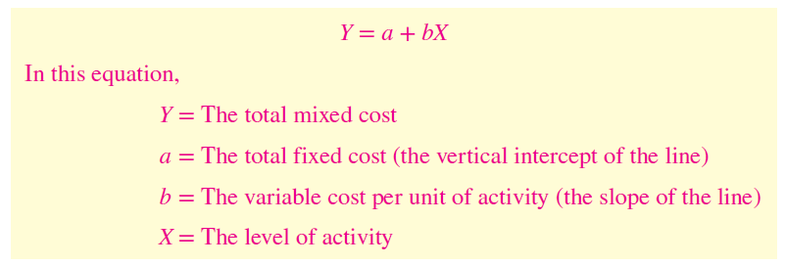
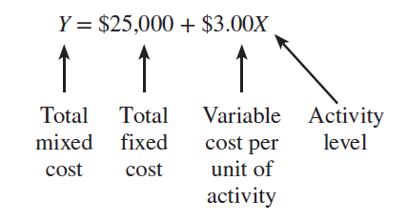
Mixed Costs
Y
Total mixed cost
Total Utility Cost
Variable Cost per KW
X
Fixed Monthly Utility Charge
Activity (Kilowatt Hours)
Notes:
The mixed cost line can be expressed with the equation Y = a + bX. This equation should look familiar, from your algebra and statistics classes.
In the equation, Y is the total mixed cost; a is the total fixed cost (or the vertical intercept of the line); b is the variable cost per unit of activity (or the slope of the line), and X is the actual level of activity.
In our utility example, Y is the total mixed cost; a is the total fixed monthly utility charge; b is the cost per kilowatt hour consumed, and X is the number of kilowatt hours consumed.

Slide 36
Mixed Costs – An Example
If your fixed monthly utility charge is $40, your variable cost is $0.03 per kilowatt hour, and your monthly activity level is 2,000 kilowatt hours, what is the amount of your utility bill?
Y = a + bX
Y = $40 + ($0.03 × 2,000)
Y =
$100
Notes:
Read through this short question to see if you can calculate the total utility bill for the month.
The total bill is $100. How did you do?

Slide 37
Revision

Slide 38
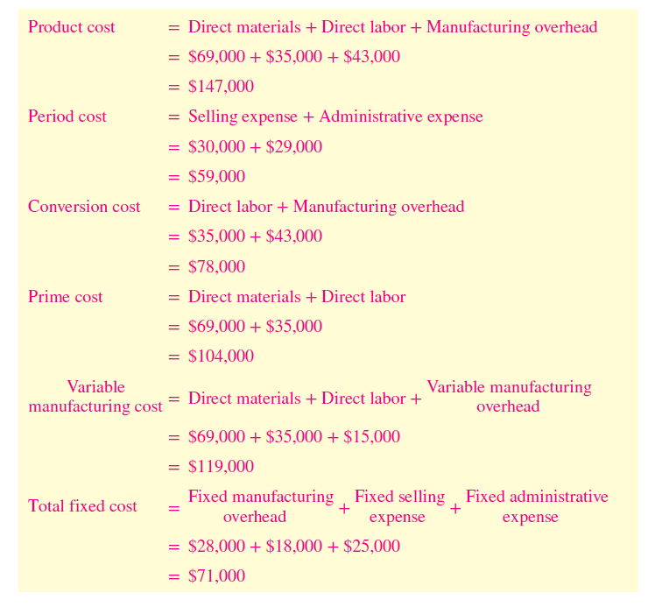
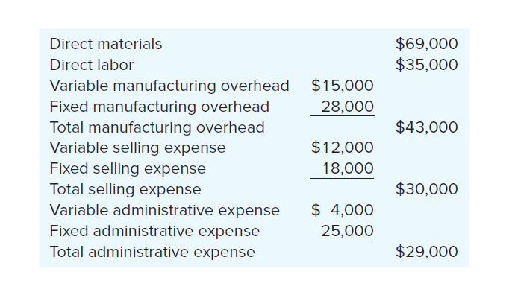
Comprehensive example
A company has reported the following costs and expenses for the most recent month:

Slide 39
Learning Objective 5
Understand cost classifications used in making decisions: differential costs, sunk costs, and opportunity costs.
Notes:
Learning objective number 4 is to analyze a mixed cost using a scattergraph plot and the high-low method.

Slide 40
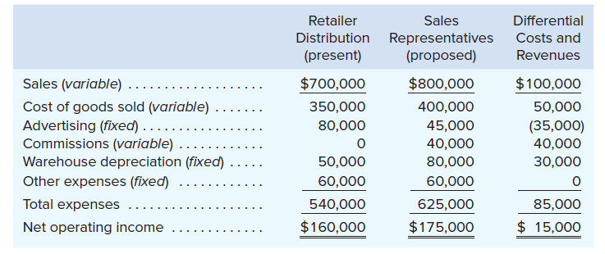
Differential Cost and Revenue
Costs and revenues that differ among alternatives. Differential costs are always relevant costs (also known as incremental cost)
E.g., Natural Cosmetics, Inc., is thinking about changing its marketing method from distribution through retailers to distribution by a network of neighborhood sales representatives.
Relevant
Relevant
Relevant
Relevant
Relevant
Not relevant
Items that are the same under all alternatives do not affect decision and can be ignored.
Notes:
Differential costs (or incremental costs) is a difference in cost between any two alternatives. Differential costs can be either fixed or variable. A difference in revenue between two alternatives is called differential revenue.
For example, assume you have a job paying $1,500 per month in your hometown. You have a job offer in a neighboring city that pays $2,000 per month. The commuting cost to the city is $300 per month. In this example, the differential revenue is $500 and the differential cost is $300.

Slide 41

Opportunity Cost
The potential benefit that is given up when one alternative is selected over another.
Example: You have a part-time job that pays $200/week. If you decided to take a vacation for a week, then $200 is lost. Opportunity cost for taking a weeklong vacation.
$200
Vacation
General rule: every alternative involves an opportunity cost
Notes:
Opportunity cost is the potential benefit that is given up when one alternative is selected over another. These costs are not usually entered into the accounting records of an organization, but must be explicitly considered in all decisions.

Slide 42

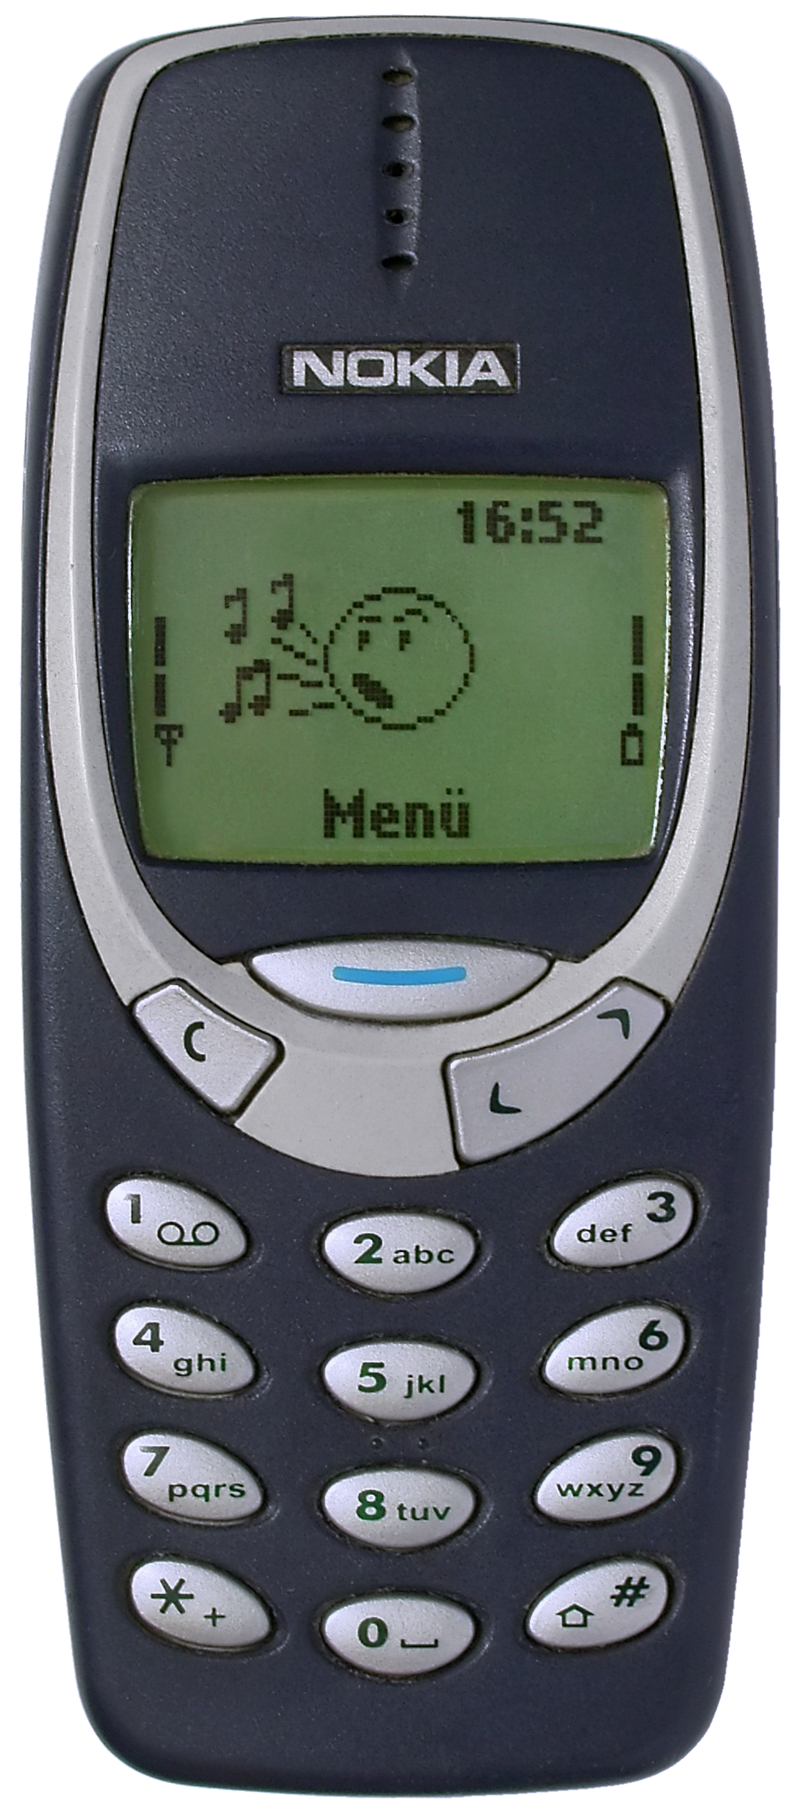
Sunk Costs
Sunk costs have already been incurred and cannot be changed now or in the future. These costs should be ignored when making decisions.
Example: A company paid $50,000 for a special purpose machine. The machine was used to make a product that is now obsolete. The cost has already been incurred and cannot be undone (hard to recover even if the company resumes manufacturing the product because no one will buy).
Notes:
A sunk cost is a cost that has already been incurred and that cannot be changed by any decision made now or in the future. Since sunk costs cannot be changed and therefore cannot be differential costs, they should be ignored in decision making. While students usually accept the idea that sunk costs should be ignored on an abstract level, like most people, they often have difficulty putting this idea into practice.

Slide 43
Quick Check ✓
Suppose you are trying to decide whether to drive or take the train to Portland to attend a concert. You have ample cash to do either, but you don’t want to waste money needlessly. Is the cost of the train ticket relevant in this decision? In other words, should the cost of the train ticket affect the decision of whether you drive or take the train to Portland?
A. Yes, the cost of the train ticket is relevant.
B. No, the cost of the train ticket is not relevant.
Notes:
Take a minute and read the information on this slide. Should the cost of the train ticket affect the decision of whether you drive or take the train to Portland?

Slide 44
Quick Check ✓
Suppose you are trying to decide whether to drive or take the train to Portland to attend a concert. You have ample cash to do either, but you don’t want to waste money needlessly. Is the cost of the train ticket relevant in this decision? In other words, should the cost of the train ticket affect the decision of whether you drive or take the train to Portland?
A. Yes, the cost of the train ticket is relevant.
B. No, the cost of the train ticket is not relevant.
Notes:
Yes, it should because the cost of the train ticket is relevant.

Slide 45
Quick Check ✓
Suppose you are trying to decide whether to drive or take the train to Portland to attend a concert. You have ample cash to do either, but you don’t want to waste money needlessly. Is the annual cost of licensing your car relevant in this decision?
A. Yes, the licensing cost is relevant.
B. No, the licensing cost is not relevant.
Notes:
Take a minute and read the information on this slide. Is the annual cost of licensing your car relevant in this decision?

Slide 46
Quick Check ✓
Suppose you are trying to decide whether to drive or take the train to Portland to attend a concert. You have ample cash to do either, but you don’t want to waste money needlessly. Is the annual cost of licensing your car relevant in this decision?
A. Yes, the licensing cost is relevant.
B. No, the licensing cost is not relevant.
Notes:
No, it is not because the licensing cost is not relevant.

Slide 47
Quick Check ✓
Suppose that your car could be sold now for $5,000. Is this a sunk cost?
A. Yes, it is a sunk cost.
B. No, it is not a sunk cost.
Notes:
Suppose that your car could be sold now for $5,000. Is this a sunk cost?

Slide 48
Quick Check ✓
Suppose that your car could be sold now for $5,000. Is this a sunk cost?
A. Yes, it is a sunk cost.
B. No, it is not a sunk cost.
Notes:
No, it is not a sunk cost.

Slide 49
Summary of the Types of Cost Classifications
Financial Reporting
Predicting Cost Behavior
Assigning Costs to Cost Objects
Making Business Decisions
Notes:
We have looked at the cost classifications used for financial reporting, predicting cost behavior, assigning costs to cost objects, and making business decisions. Now, let’s look at how to classify idle time, overtime, and fringe benefits.

Slide 50
Learning Objective 6
Prepare income statements for a merchandising company using the traditional and contribution formats.
Notes:
Learning objective number 5 is to prepare income statements for a merchandising company using the traditional and contribution formats.

Slide 51
The Traditional and Contribution Formats
Used primarily for external reporting.
Used primarily by management.
Notes:
The contribution format allocates costs based on cost behavior. The contribution approach differs from the traditional approach illustrated in an earlier chapter.
The traditional approach organizes costs in a functional format. Costs relating to production, administration, and sales are grouped together without regard to their cost behavior.
The traditional approach is used primarily for external reporting purposes.

Slide 52
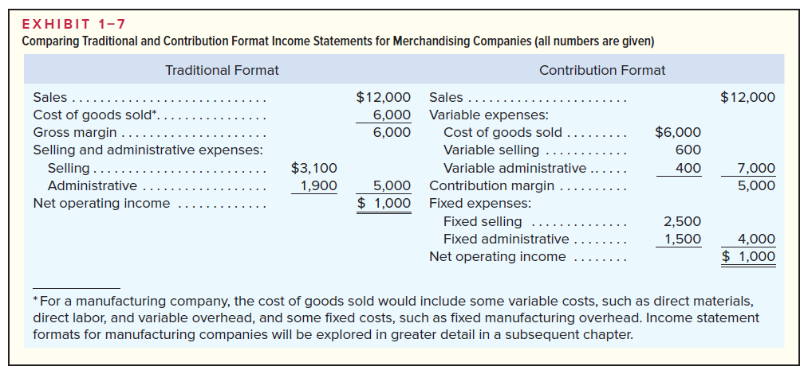
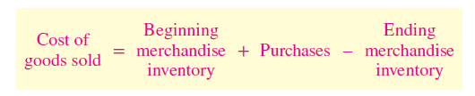
*

Slide 53
Uses of the Contribution Format
The contribution income statement format is used as an internal planning and decision-making tool. We will use this approach for:
Cost-volume-profit analysis (Chapter 5).
Budgeting (Chapter 8).
Segmented reporting of profit data (Chapter 6).
Special decisions such as pricing and make-or-buy analysis (Chapter 12).
Notes:
This approach is used as an internal planning and decision-making tool. For example, this approach is useful for and discussed further in Cost-volume-profit analysis (Chapter 5), Budgeting (Chapter 8), Segmented reporting of profit data (Chapter 6), Special decisions such as pricing and make or buy analysis (Chapter 12).

